Slide 1

Project Title: Embedded IoT-based smart water tank level monitoring and automatic pump control system.
Adeen Asif (23-NTU-CS-1007)
Meerab Zahra (23-NTU-CS-1049)

Slide 2
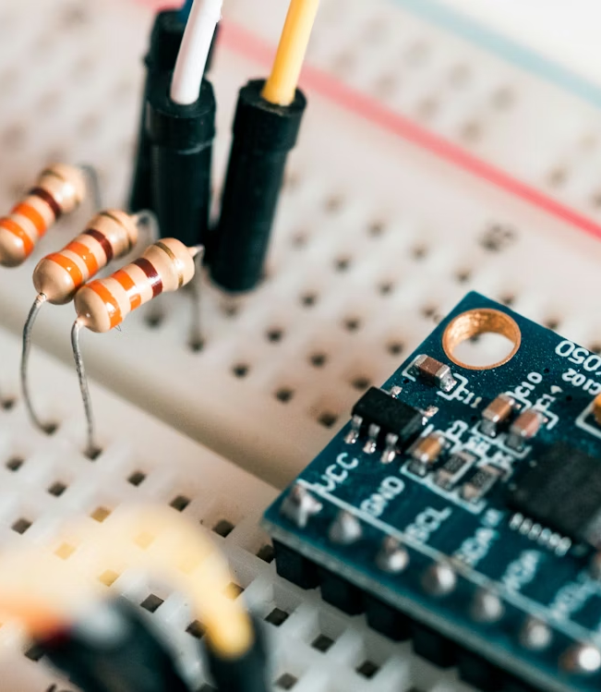

Introduction:
Monitors tank water level using ultrasonic sensors.
Automates pump operation based on water level. Provides a manual mode to control the pump directly.
Enables remote access and control via the Blynk app.
Supports real-time data monitoring and control using Blynk app and Node-RED MQTT for IoT integration.

Slide 3
Problem Statement:
Manual water level monitoring causes water wastage, pump overuse, and lack of real-time information. An automated IoT-based system is needed for real-time monitoring, remote access, and automatic pump control to ensure efficient water management.

Slide 4
Objectives:
Real-time Water Level Monitoring
Automatic Pump Control
Cloud-based Monitoring (Blynk)
Water Level Display
Alert System
Resource Optimization
Node-Red MQTT for central monitoring

Slide 5
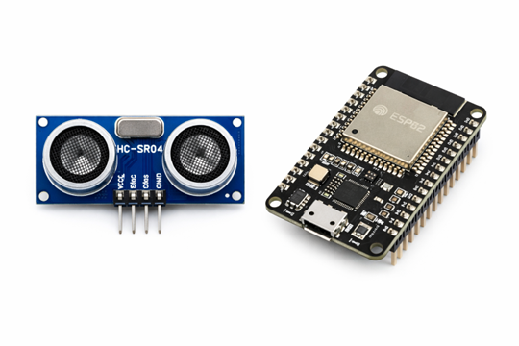
Hardware Components:
ESP32 Microcontroller
HC-SR04 Ultrasonic Sensor
5V Relay Module
LEDs & Buzzer
OLED Display
Jumper Wires & Breadboard
Demo Load (Pump Simulation)
5

Slide 6

Software Components:
Platform IO / VS Code
ESP32 Libraries (Wi-Fi, Sensors, OLED)
Blynk for IoT & cloud monitoring
Node-Red MQTT
6

Slide 7
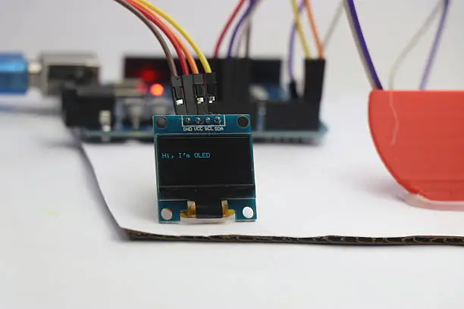
Water Level Logic:
Water level calculated from ultrasonic sensors
Logic:
Pump ON if 0 ≤ level < 90%
Pump OFF if ≥90%

Slide 8
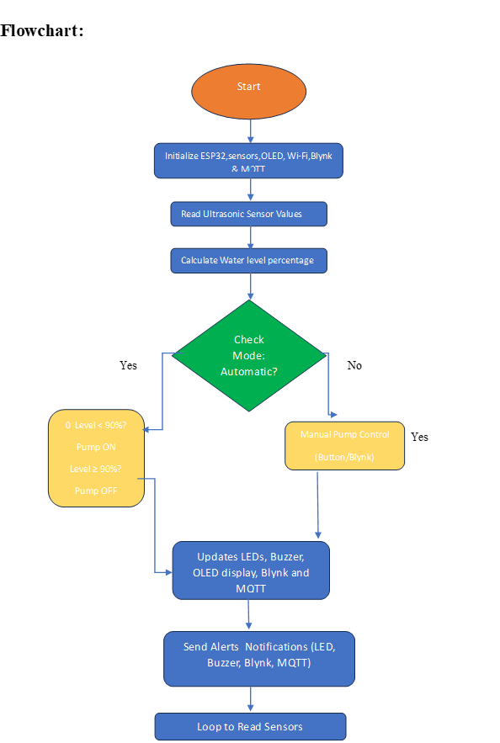
System Flowchart Steps:

Slide 9
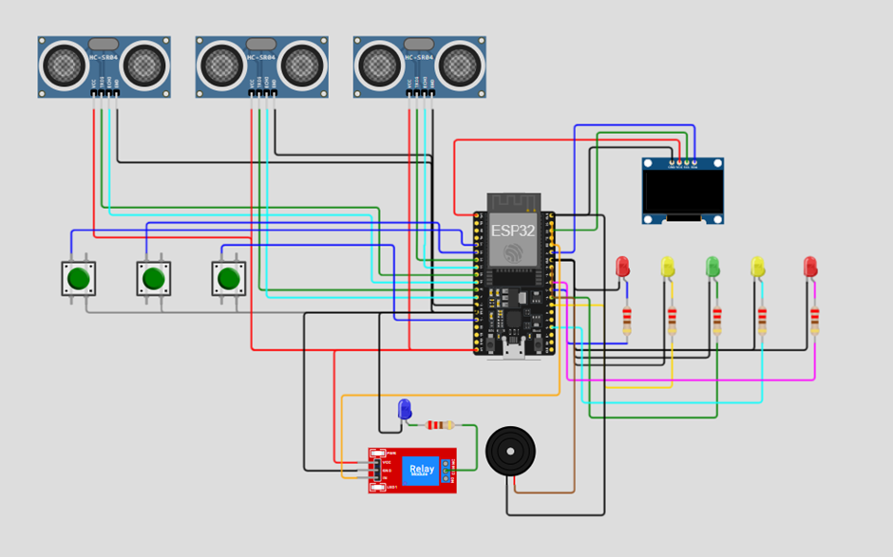
Circuit Diagram:

Slide 10
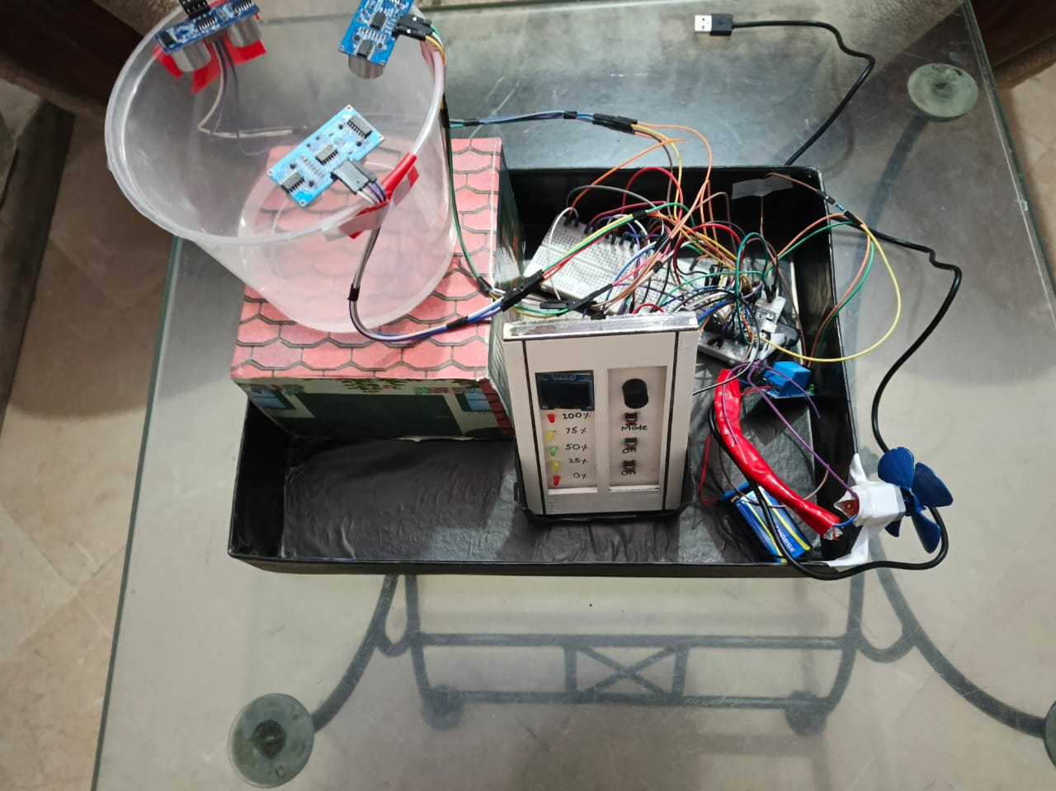
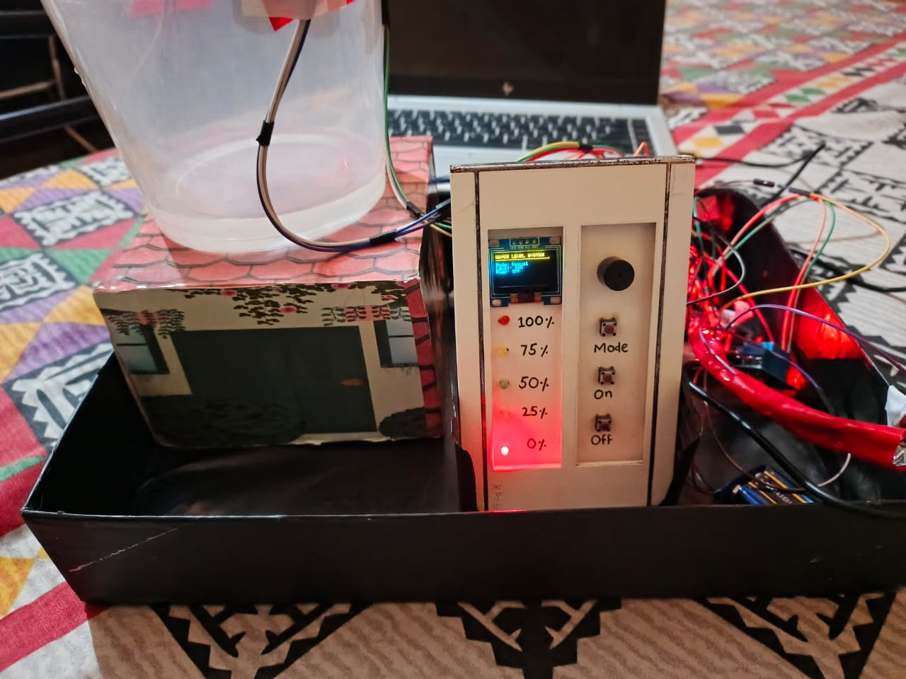
Hardware:

Slide 11
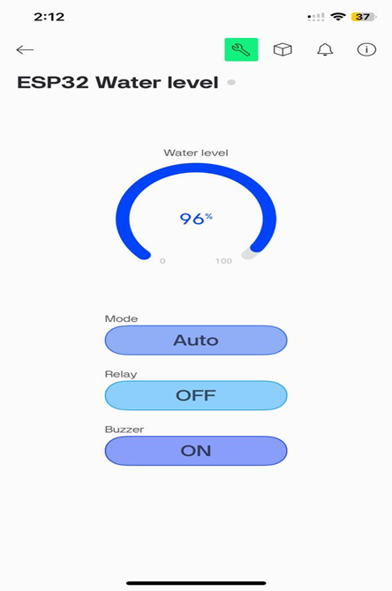
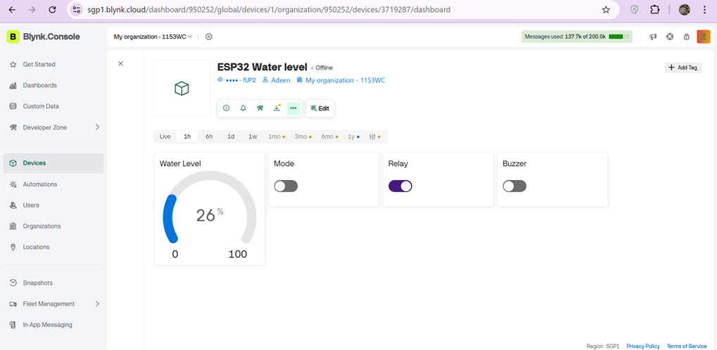
Blynk dashboard Mobile and Web:

Slide 12
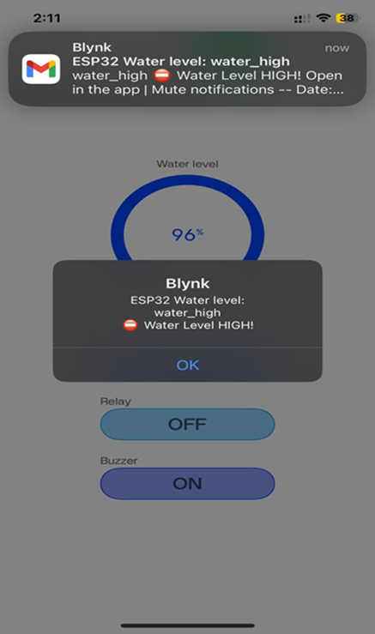
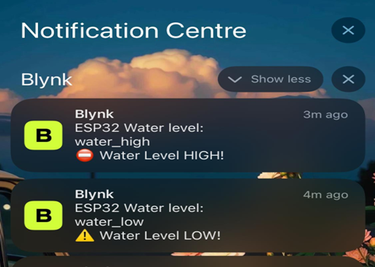
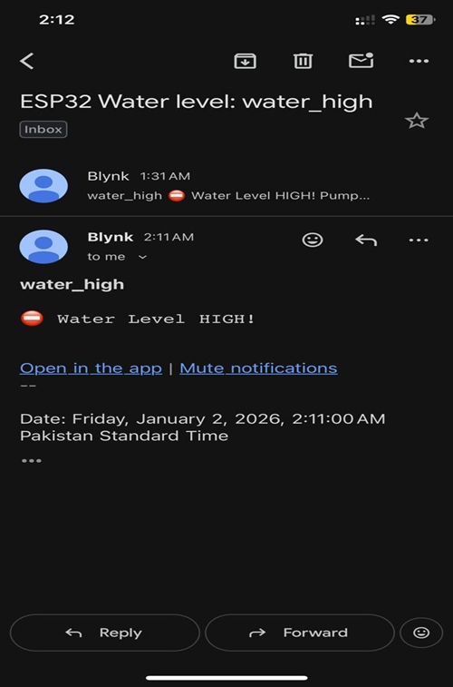
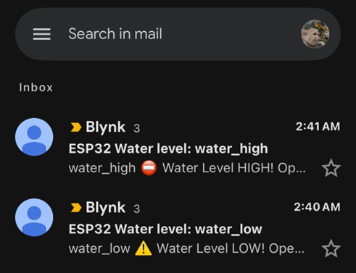
Blynk notifications:

Slide 13
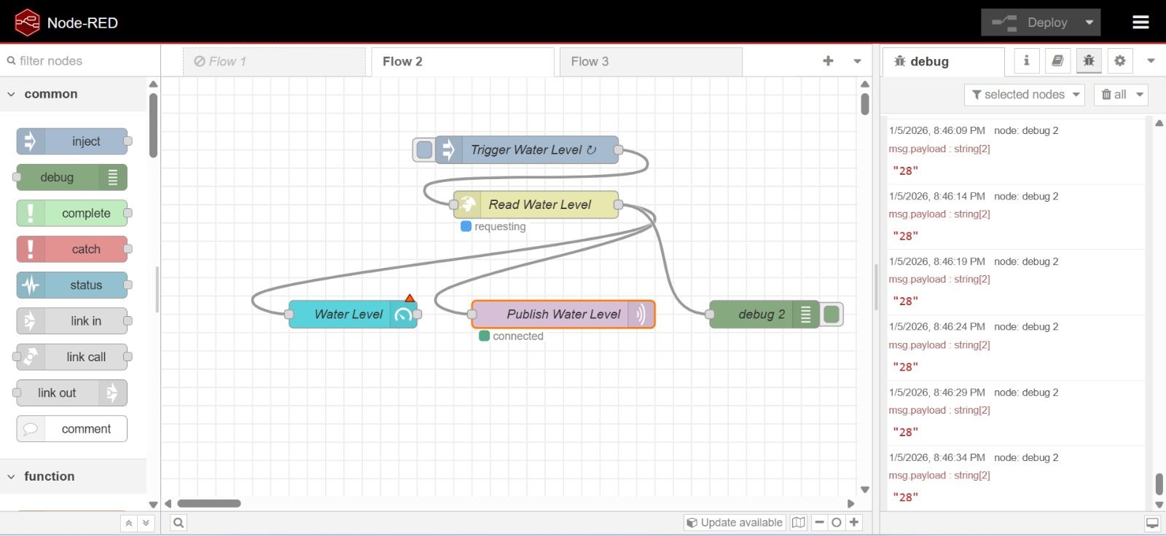
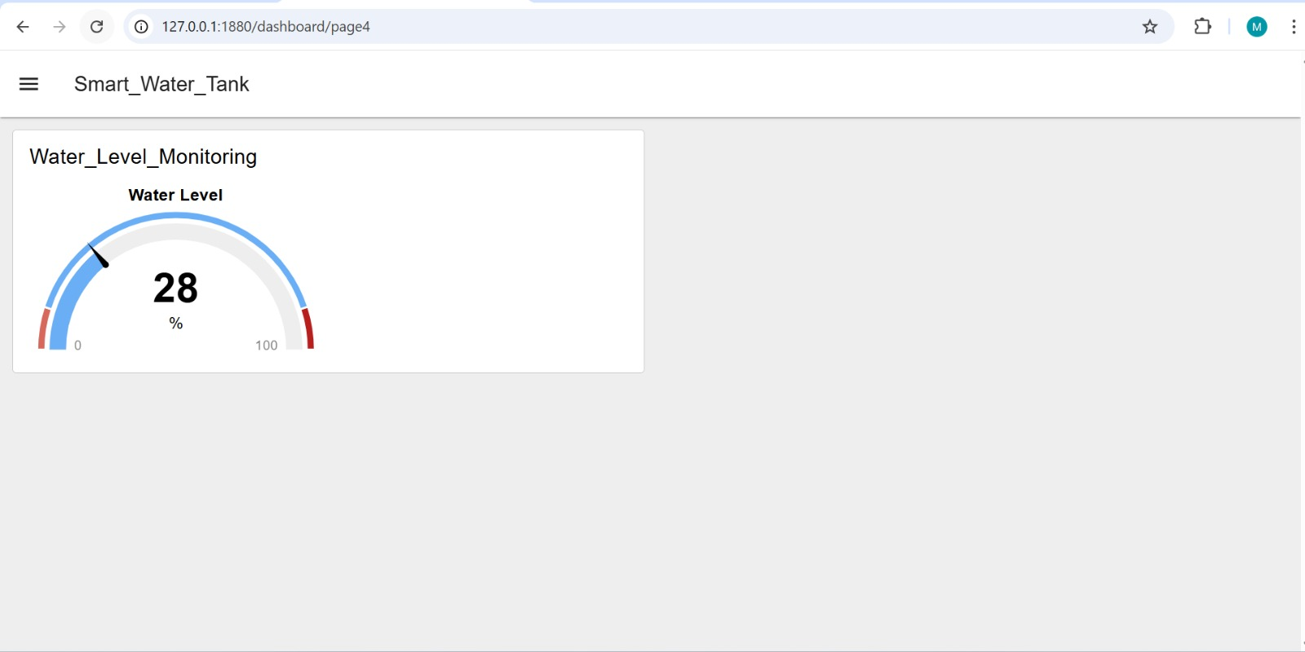
Node-Red MQTT:

Slide 14
Conclusion:
Automated water tank management prevents overflow and dry-run.
Real-time monitoring via IoT ensures efficient water usage.
Manual and automatic modes provide flexibility and control.
Alerts via LEDs and buzzer enhance safety and awareness.
Blynk provide real-time monitoring.
Node-Red MQTT provides central monitoring and control.
14

Slide 15
Thank you

